Slide 1

Data Science and the Data Scientist Toolkit
Notes:
Adapted with <3 by Lindsey Berlin

Slide 2

Agenda
What is Data Science?
Roles and Responsibilities
The Process
The Data Science Toolkit (Phase 1)

Slide 3

So: What is Data Science?
Notes:
Open up the floor to discussion - they just started a 15 week intensive program, what do they think data science is? Give at least a long awkward pause, and try to elicit some responses, before moving to the next slide

Slide 4

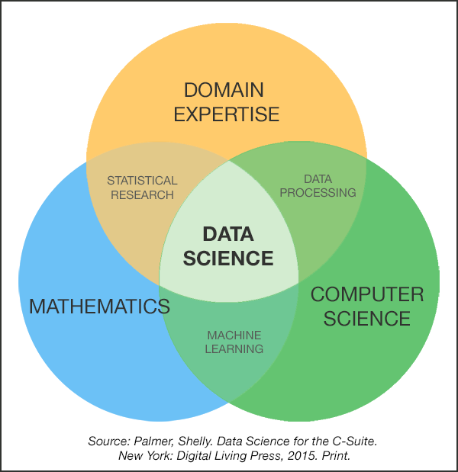
The Data Science Venn Diagram
Notes:
Source: Drew Conway - http://drewconway.com/zia/2013/3/26/the-data-science-venn-diagram
This was the original DS venn diagram… there are dozens more out there now!

Slide 5

A data scientist is responsible for collecting, analyzing and interpreting data on various scales.
Offshoot of several traditional technical roles, including mathematician, scientist, statistician and computer professional.
Notes:
A broad definition that captures some nuance: the job might focus more on collecting, or on analyzing, or on interpreting, and it’s a role that is so nuanced because there was a time before “data scientist” was a term used broadly.
Source: https://www.techtarget.com/searchenterpriseai/definition/data-scientist

Slide 6

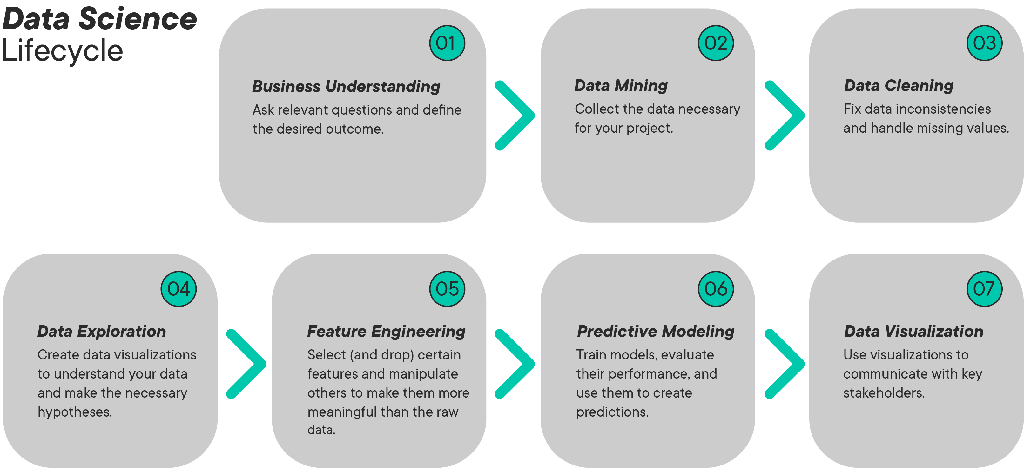
The Data Science Process
Notes:
Why do we need those three (or four) buckets of skills? To follow the data science process!
There are dozens of visualizations that show the ‘data science process’ - and plenty of data science workflows that some companies/teams follow (go through these next few slides quickly, talking about similarities and main takeaways about what a data science project even is)
Image Source: https://learn.nashvillesoftwareschool.com/blog/2017/08/22/data-science-process

Slide 7
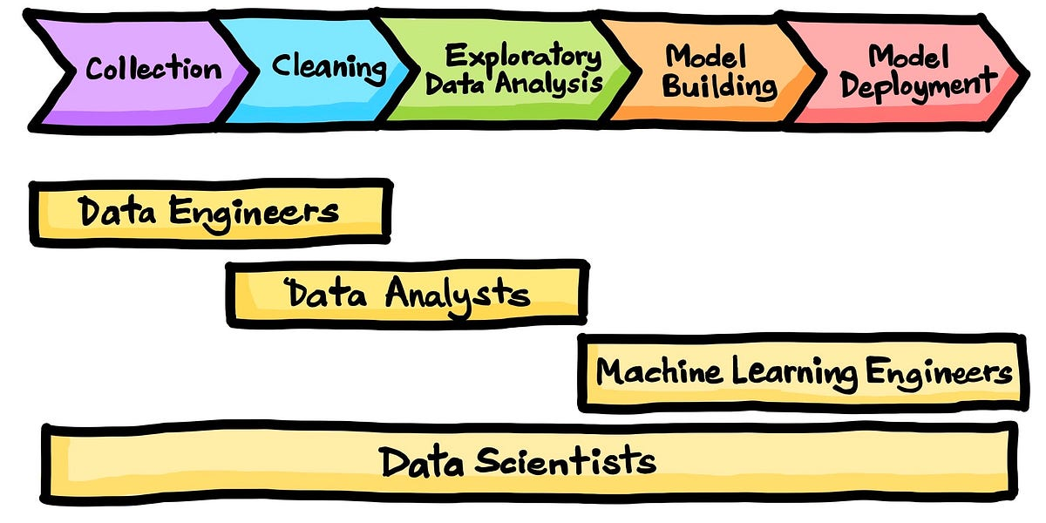
Commn Roles in the Data Science Process

Slide 8
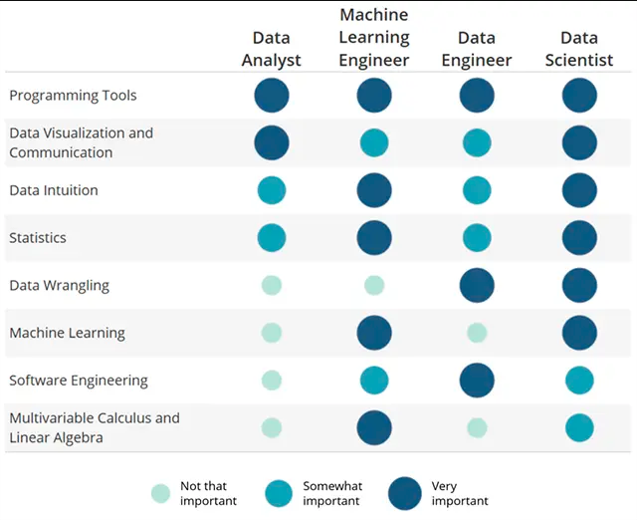
Common Roles & Responsibilities
Notes:
Image Source: https://www.udacity.com/blog/2014/11/data-science-job-skills.html
Common roles we see our students enter, and thow the skills emphasized / responsibilities change across those roles - we touch on all of them, and data science is often the nexus of these skills/responsibilities, which is why that’s the name of our program! But note - if we asked 5 other places to hash out these skills and how they match up to a job title, we’d get 5 different answers. When looking for employment, it’ll be much more important to ask about responsibilities, projects, and expected outcomes, rather than looking at job title alone!

Slide 9

Understanding the problem
Initial question formulation: translating a set of problems into questions/tasks answerable by data analytics.
- Defining key relevant metrics or observables related to questions.
- Clearly understanding relationship between questions and metrics
- Understanding relevant determinants of metrics and predicting behavior based off of these.
Notes:
Be sure to discuss the more ‘official’ versions of the data science process, in terms of names for the process that might come up in an interview or something - here’s CRISP-DM
Image Source: https://www.stellarconsulting.co.nz/data/crisp-dm-still-a-leader/

Slide 10
Problem Formulation
Transformation: Question into data science workflow/task.
Data Acquisition:
Imdb
Rotten Tomatoes
etc.
Visualization and Data Exploration
- Return on investment?
- Critical acclaim (aggregated critic scores?)
- Exposure (popularity)
Data Cleaning + Transformation:
Grouping
Derived variables
Data filtering
Set of dependent factors
vs.
metrics
Data Science / ML modeling and interpretation
Notes:
Be sure to discuss the more ‘official’ versions of the data science process, in terms of names for the process that might come up in an interview or something - here’s CRISP-DM
Image Source: https://www.stellarconsulting.co.nz/data/crisp-dm-still-a-leader/

Slide 11
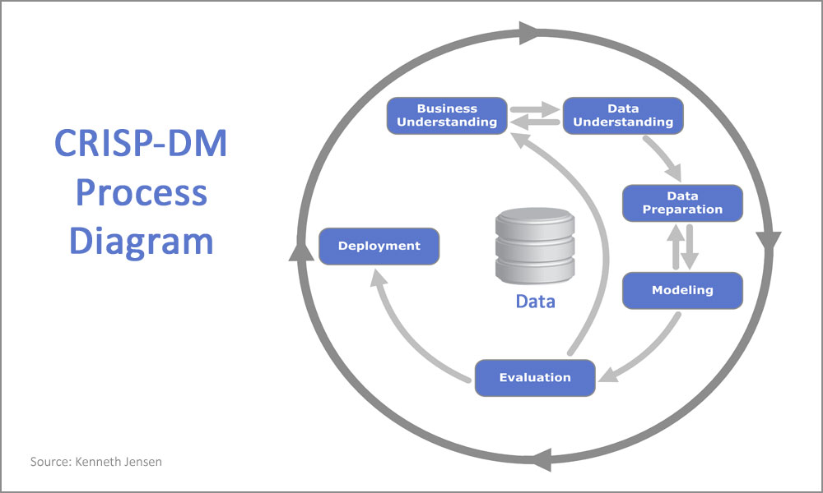
But it’s actually an iterative process…
Notes:
Be sure to discuss the more ‘official’ versions of the data science process, in terms of names for the process that might come up in an interview or something - here’s CRISP-DM
Image Source: https://www.stellarconsulting.co.nz/data/crisp-dm-still-a-leader/

Slide 12
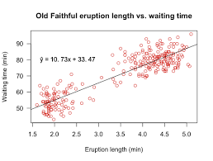
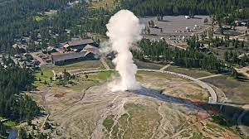
Some typical Data Science problems
Regression:
Old Faithful
Predict time between eruptions based on previous eruption duration.
Notes:
Be sure to discuss the more ‘official’ versions of the data science process, in terms of names for the process that might come up in an interview or something - here’s CRISP-DM
Image Source: https://www.stellarconsulting.co.nz/data/crisp-dm-still-a-leader/

Slide 13
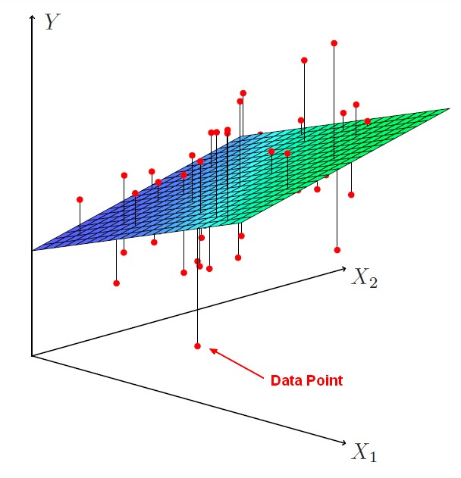
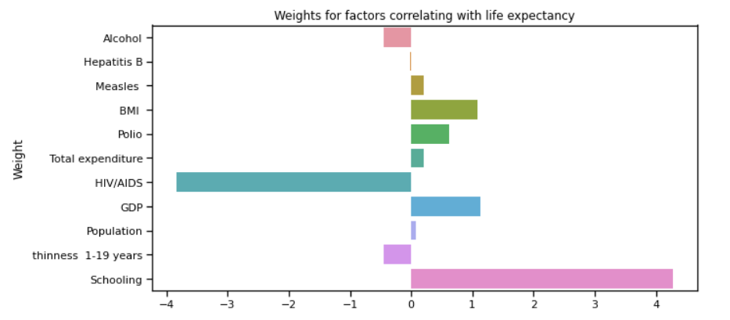
Some typical Data Science problems
Regression with many variables
Estimate factor importance based on fitted regression weights
Notes:
Be sure to discuss the more ‘official’ versions of the data science process, in terms of names for the process that might come up in an interview or something - here’s CRISP-DM
Image Source: https://www.stellarconsulting.co.nz/data/crisp-dm-still-a-leader/

Slide 14
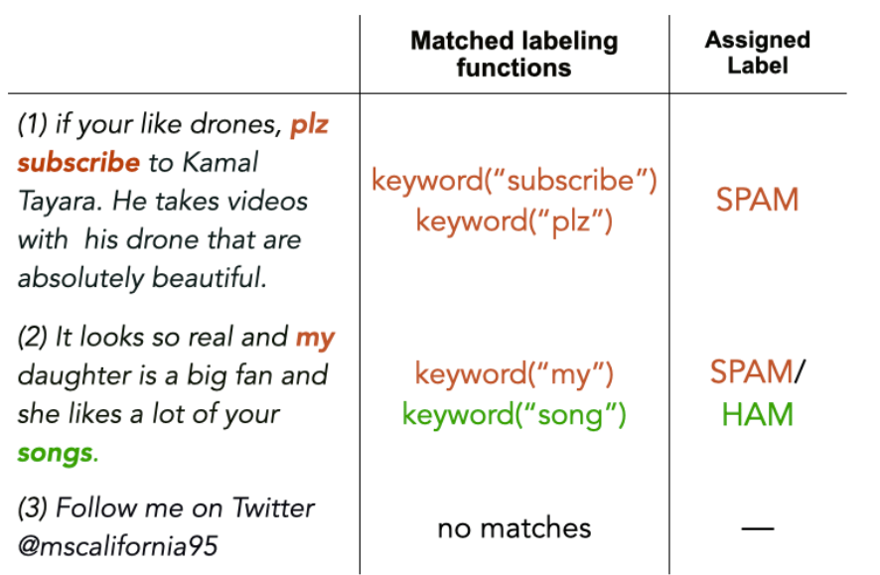
Some typical Data Science problems
Classification:
Construct features:
- Predict spam or not spam.
Notes:
Be sure to discuss the more ‘official’ versions of the data science process, in terms of names for the process that might come up in an interview or something - here’s CRISP-DM
Image Source: https://www.stellarconsulting.co.nz/data/crisp-dm-still-a-leader/

Slide 15


Some typical Data Science problems
Image Classification:
or
Koala
Red Panda?
Notes:
Be sure to discuss the more ‘official’ versions of the data science process, in terms of names for the process that might come up in an interview or something - here’s CRISP-DM
Image Source: https://www.stellarconsulting.co.nz/data/crisp-dm-still-a-leader/

Slide 16
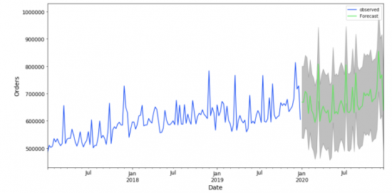
Some typical Data Science problems
Time series forecasting:
Notes:
Be sure to discuss the more ‘official’ versions of the data science process, in terms of names for the process that might come up in an interview or something - here’s CRISP-DM
Image Source: https://www.stellarconsulting.co.nz/data/crisp-dm-still-a-leader/

Slide 17
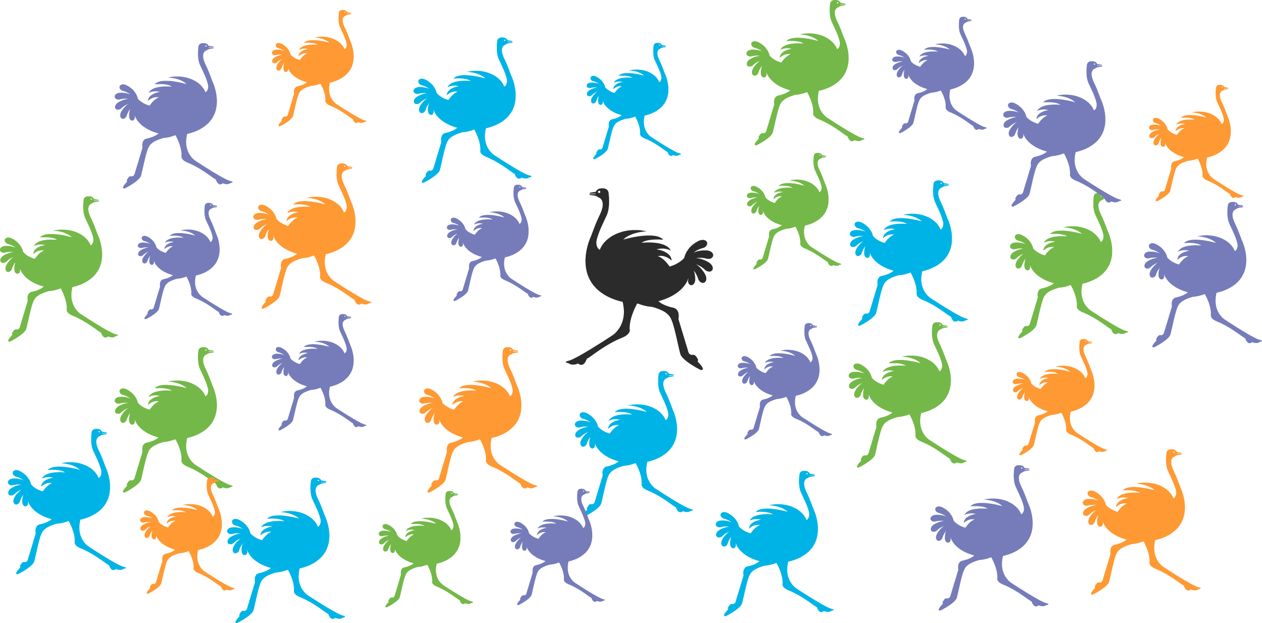
Some typical Data Science problems
Anomaly detection:
Notes:
Be sure to discuss the more ‘official’ versions of the data science process, in terms of names for the process that might come up in an interview or something - here’s CRISP-DM
Image Source: https://www.stellarconsulting.co.nz/data/crisp-dm-still-a-leader/

Slide 18
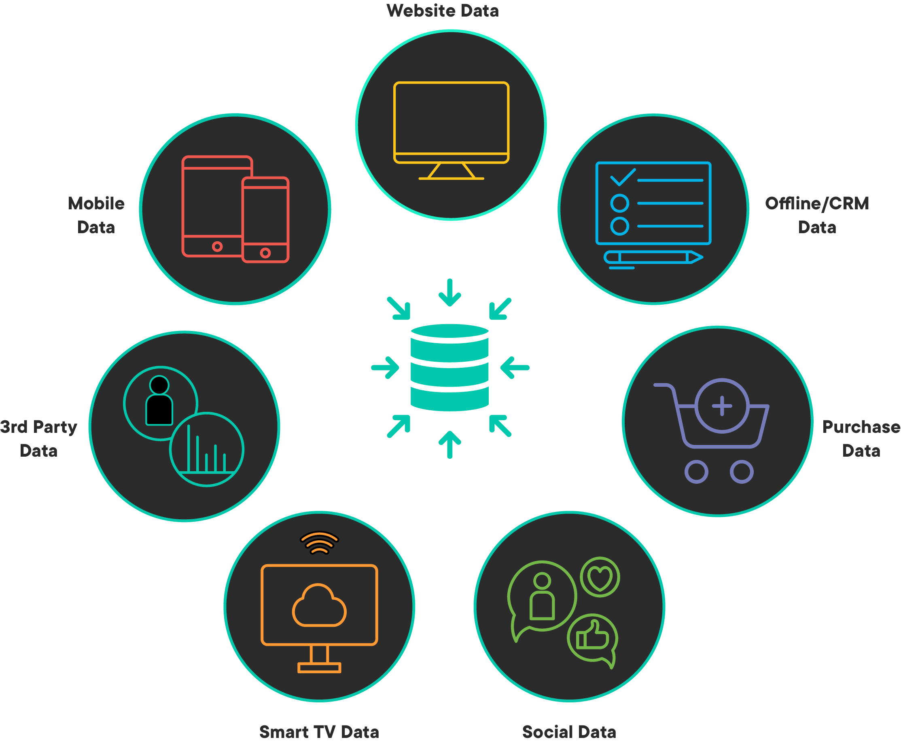
Data you might encounter
Notes:
Be sure to discuss the more ‘official’ versions of the data science process, in terms of names for the process that might come up in an interview or something - here’s CRISP-DM
Image Source: https://www.stellarconsulting.co.nz/data/crisp-dm-still-a-leader/

Slide 19
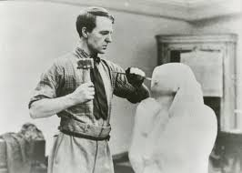
Be the data sculptor
Reshape the data:
Clean and transform the data.
Data in a useful form: modeling effectively, answering your question.
An art form.
Notes:
Be sure to discuss the more ‘official’ versions of the data science process, in terms of names for the process that might come up in an interview or something - here’s CRISP-DM
Image Source: https://www.stellarconsulting.co.nz/data/crisp-dm-still-a-leader/

Slide 20
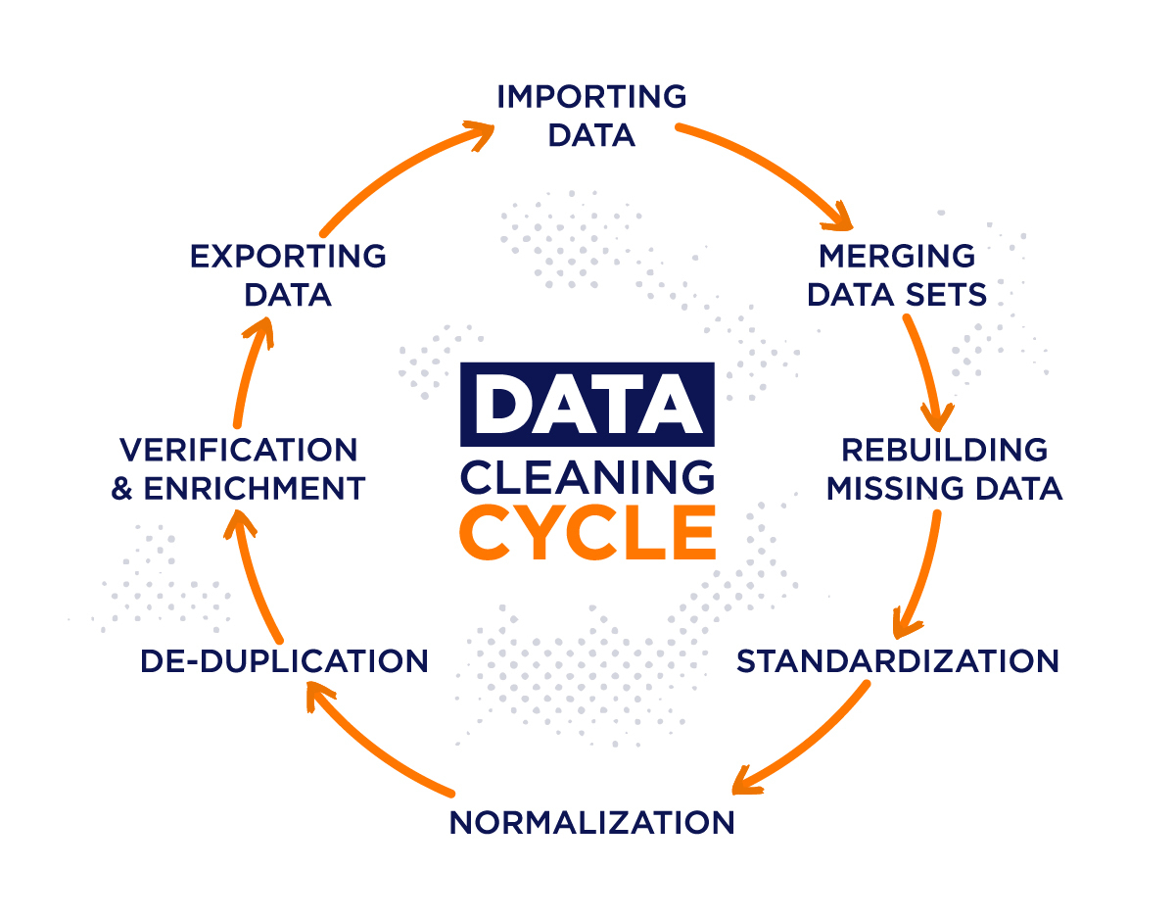
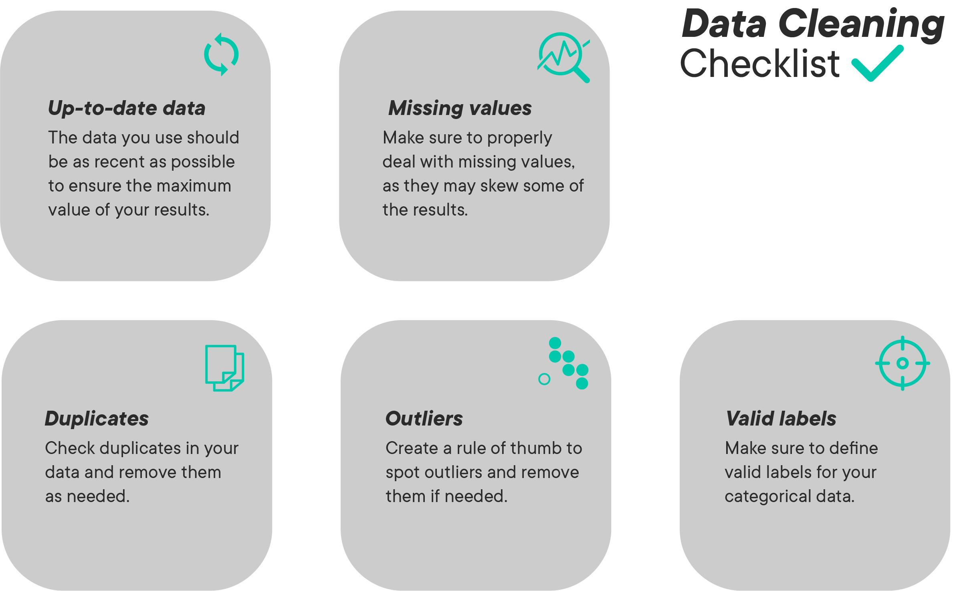
Where data scientists spend most of their time…
Notes:
Be sure to discuss the more ‘official’ versions of the data science process, in terms of names for the process that might come up in an interview or something - here’s CRISP-DM
Image Source: https://www.stellarconsulting.co.nz/data/crisp-dm-still-a-leader/

Slide 21
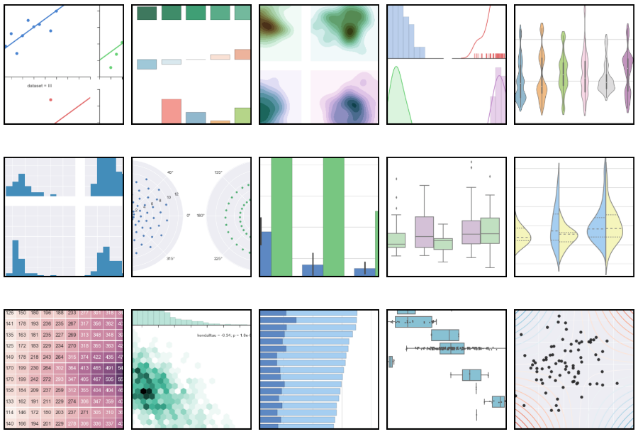
Exploratory Data Analysis
Visualize and understand your data to transform into useful form.
Notes:
Be sure to discuss the more ‘official’ versions of the data science process, in terms of names for the process that might come up in an interview or something - here’s CRISP-DM
Image Source: https://www.stellarconsulting.co.nz/data/crisp-dm-still-a-leader/

Slide 22

Feature Engineering
Transform raw data into meaningful features that directly address the problem you are trying to solve.
Notes:
Be sure to discuss the more ‘official’ versions of the data science process, in terms of names for the process that might come up in an interview or something - here’s CRISP-DM
Image Source: https://www.stellarconsulting.co.nz/data/crisp-dm-still-a-leader/

Slide 23
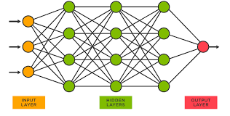
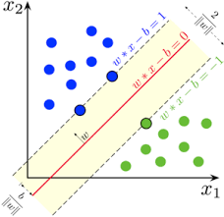
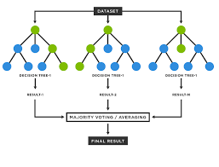
Modeling
Neural Network.
Support Vector Machine
Random Forests
And more…try different models/algorithms for a given task, tune, see what works best.
Notes:
Be sure to discuss the more ‘official’ versions of the data science process, in terms of names for the process that might come up in an interview or something - here’s CRISP-DM
Image Source: https://www.stellarconsulting.co.nz/data/crisp-dm-still-a-leader/

Slide 24
Presenting/visualizing results
This is key to a data scientist:
Presentations/Reports
Know your audience
State the problem clearly.
How did you go about solving the problem?
Key factors
Visualizations of data
Model findings and visualizations
Making recommendations.
Notes:
Be sure to discuss the more ‘official’ versions of the data science process, in terms of names for the process that might come up in an interview or something - here’s CRISP-DM
Image Source: https://www.stellarconsulting.co.nz/data/crisp-dm-still-a-leader/

Slide 25

Bad Sign
Notes:
Be sure to discuss the more ‘official’ versions of the data science process, in terms of names for the process that might come up in an interview or something - here’s CRISP-DM
Image Source: https://www.stellarconsulting.co.nz/data/crisp-dm-still-a-leader/

Slide 26
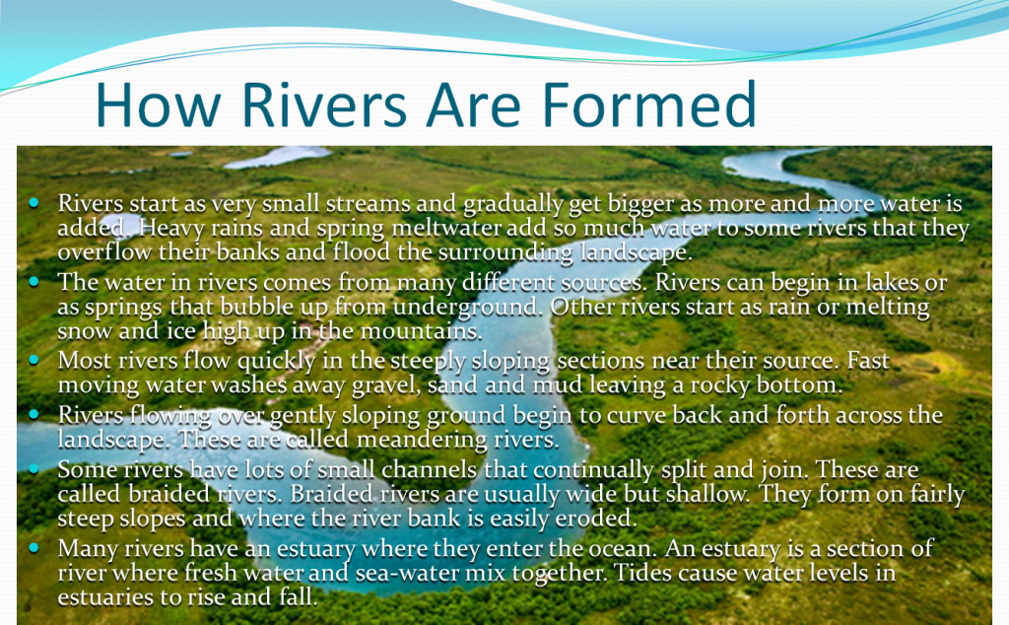

Slide 27
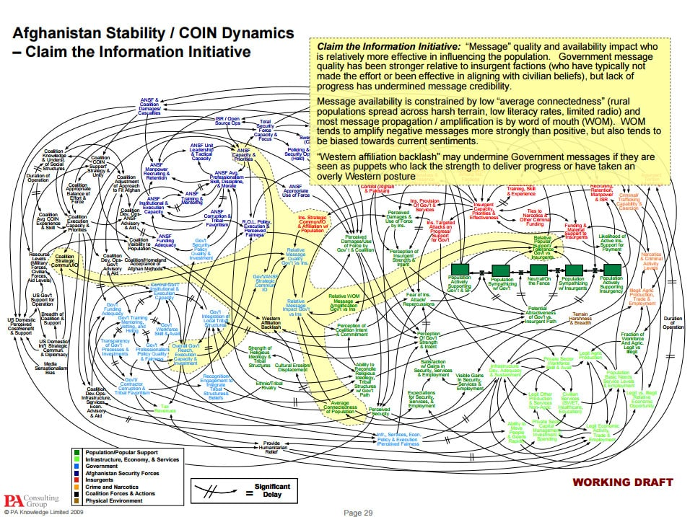
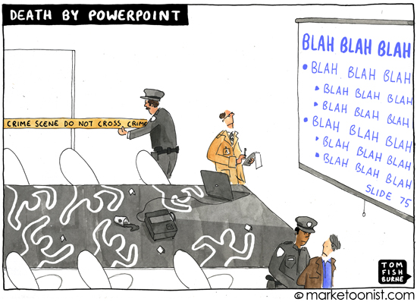
Avoid: busy visualizations/slides
Notes:
Be sure to discuss the more ‘official’ versions of the data science process, in terms of names for the process that might come up in an interview or something - here’s CRISP-DM
Image Source: https://www.stellarconsulting.co.nz/data/crisp-dm-still-a-leader/

Slide 28
The Data Science Toolkit
Notes:
AKA what tools are we starting off with in this program that are building the technical skills you’ll need to succeed?

Slide 29










Data Science Toolkit - Phase 1
Languages
Interfaces
Version Control
Package Management
Notes:
We’ll focus on these 4 sections today - these are the main technical tools we’ll introduce in Phase 1, and all will be vital as you progress through the program. This aren’t the only tools you’ll use by the time you finish the program, but these are our core tools and are thus the ones we’ll start with during phase 1! Can note that today’s focus is to touch at a high level on these concepts, and prep students to move through the curriculum - not to go too deep
What is python? What is SQL?
Where do we do those things? AKA jupyter notebooks/IllumiDesk and VS Code
How do we keep track of the versions of our code? Git/github
How do we keep track of the versions of our Python? Anaconda (also pip)

Slide 30

Languages
Python
Free, open source, versatile, powerful
Not just for data science!
Object-oriented (everything is an ‘object’)
The Zen of Python
Structured Query Language (SQL)
Connect to, change, and retrieve data from relational databases
Developed in the 1970s, still going strong
Many flavors
Notes:
Our two primary languages: Python throughout the course, and SQL for mostly Phase 1 (both are vital to employers though!)
Python is our day-to-day bread and butter - not just base Python, but the many libraries which have been developed and released to help us do common DS tasks. Can discuss how it’s not just for DS, and the flexibility of its libraries makes it accessible and convenient (compared to something more specific and limited, like R). Touch on the Zen of Python to discuss the goals students should have when writing python.
SQL allows us to speak the language of where data often lives, relational databases - it’s a query language, but it’s very flexible and has withstood the test of time. We teach the core syntax and query structure, which can easily translate across the many dialects of SQL out there (PostgreSQL, MySQL, Oracle, SQL Server, etc)

Slide 31
Interfaces
Jupyter Notebooks
Interactive notebook-style interface for running code, data analysis and visualizations. Like a lab notebook.
IllumiDesk
Hosts Jupyter Notebooks in the cloud
Code-Focused Text Editor
Write text files in a code-native format
VS Code is one of many that would work
Notes:
Project Jupyter: “a non-profit, open-source project, born out of the IPython Project in 2014 as it evolved to support interactive data science and scientific computing across all programming languages. Jupyter will always be 100% open-source software, free for all to use and released under the liberal terms of the modified BSD license.” - https://jupyter.org/about
IllumiDesk hosts these open source notebooks, giving you access to server space in a maintained environment (and helping us release, collect, and grade assignments like checkpoints and code challenges)
A text editor that’s designed to work with code is vital to taking your experience beyond the notebook, and is how most code is written - this will mostly look like READMEs and .py files for us in this course, but familiarity with a code editor is vital - we recommend VS Code but there are other options (Vim, Atom, Sublime) all of which would be fine to use in this course

Slide 32

Version Control
Git
Tracks file/project history
Allows one to work on/track/manage multiple versions of a project.
Project folder → “Repository”
GitHub
Hosts Git repositories
Collaborate and share code with others
Backbone of the open source community
Your Data Science portfolio!
Notes:
Definitely want to emphasize how this is about saving and sharing YOUR CODE and YOUR WORK - the versioning on the next slide is related to keeping track of the versions of the languages you use (package versions)
Ah, Git. Developed in 2005, it’s a distributed version control system, free and open source, which allows for non-linear and distributed development and can work well with both small and large projects. It can feel really unwieldy at first, but it’s ubiquitous - it relies on saves (commits) to build a history of files, and is organized around repositories (which are just fancy folders/directories that you’re tracking with git)
GitHub is a place to host your git repositories - aka, the place in the cloud that can help you save and share what you’re developing. The world runs on GitHub - all of our python libraries, for example, are just repositories under the hood. We host our entire curriculum on GitHub, and you will use it both to collaborate with each other and as a place to showcase your DS portfolio. Not the only service like this (Atlassian’s BitBucket, GitLab, etc)

Slide 33
Library Management
Anaconda
Package management (download/delete Python libraries)
Resolve library conflicts
Create and share environments (collection of libraries used for specific project)
Python Package Index (PyPi)
Database of public Python libraries
Package installer (pip)
Not everything is on Anaconda
Notes:
Versioning - aka how to manage the fact that libraries (and python!) are constantly updating, often at different rates. We’ll have you use our environment (learn-env) for now - then down the line you might move to other environments as you branch out and pursue many other projects!
Definitely want to emphasize how this versioning is about PACKAGE VERSIONS related to the languages you used when working - while the version control on the previous slide is about saving and sharing your specific code/work.
Anaconda is a package manager, aka it’ll help you access python libraries. When you download a new library, Anaconda helps make sure that new library and all the old ones you have will play well together! Anaconda also allows you to create and switch between multiple environments, depending on what you need for your current project, and helps you share your environment details with others
Pip is the package management system for python libraries, connecting to the Python Package Index, where public Python packages are published - but it does less maintenance work than Anaconda. Try to find a conda installation method first, but pip installing a library likely won’t break anything

Slide 34
Now: Time to Get Started!
Notes:
Time-permitting, can go through and discuss the two

